Slide 1
Context Based For Recommendation System
Shan Markus Susanto - 1701498326

Slide 2
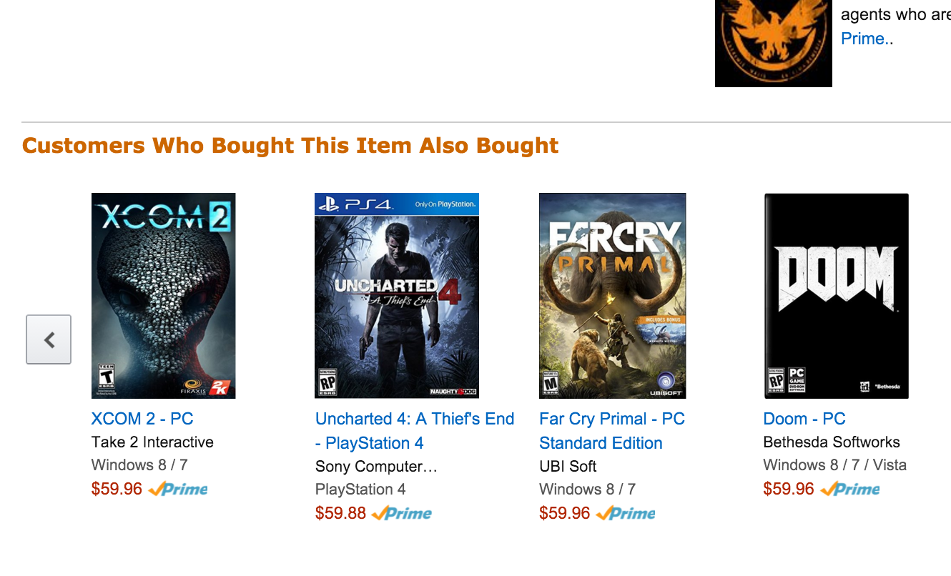
Background
Recommendation is everywhere
Better Content for the user
Helps the company to grow
Big Data Era
Notes:
Explain example such as amazon (E-commerce), Facebook Find Friend feature, place recommendation -> It’s something important or necessary that company (who sells service or item) -> That’s why this topic is interesting to be explored
In addition (Use the picture) after I personally bought a game the RS will automatically search the same item which has the same characteristic (not random) and suggest me the items which gives me a feeling that the company understand what I like or love. In addition even Lazada (ecommerce) give me a bundle of what item that will be fit in the past item that I have bought
3. It said the recommendation tool helps the market gain almost 35% of the profit rates.
4. We live in

Slide 3
Problem Definition
Reachable Context are collectible and everywhere !
Does implementing the context to the Recommendation System (RS) will bring a great impact or improvement towards the accuracy to the RS
Notes:
A context, which defined by Merriam Webster as the interrelated conditions in which something exists or occurs. A use of mobile device has a capability for monitoring user location and other service related that can play a part as the context for the RS.
For instance, a location is a context which can be putted to a RS to create a recommendation to people near that location.
In addition, time is another context that can be assign to give a specific time related recommendation to the user.

Slide 4

Aims
To compare context based algorithm between Collaborative Filtering (CF) and Content Based Filtering (CBF) using company data
To investigate if adding context to the process can improve the RS
To implement RS using Graph Database Technology
To be able to create RS that using previous algorithm and providing promotion recommendation data for PT. ABC in daily basis

Slide 5

To create better predictive analysis and targeted market then eventually will the current company to gain more customer and profits.
The result of this thesis can become academic contribution for the next context based analysis for RS

Slide 6
Methodology

Slide 7
PT. ABC
Notes:
Pomona adalah sebuah Hyperlocal Shopping Companion yang memiliki misi untuk memberikan Reward untuk aktifitas keseharian Anda

Slide 8
Data
Which category is viewed the most in a particular mall ?
Promo view ranking
Banner view ranking
Education, works, age, gender, interests
How many virtual check ins ? Where are there ?

Slide 9
Solution Proposed

Slide 10
Context Possibility
 | Context | Value
Time | Time | Moring, Afternoon, Night
Location | Location range | Near, Mid, Far
Weather | Weather | Rainy, Cloudy, Sunny
Income | Income | Low, Medium, high
City Target | City | Suburbs, City, Rural

Slide 11

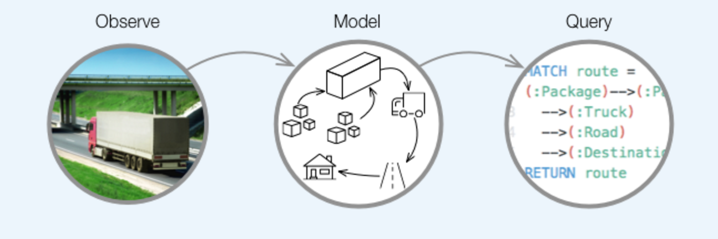
Technology
Notes:
Graph databases were the fastest growing type of database in 2014
------
The fundamental units that form a graph are nodes and relationships. In Neo4j, both nodes and relationships can contain properties.
Nodes are often used to represent entities, but depending on the domain relationships may be used for that purpose as well.
Apart from properties and relationships, nodes can also be labeled with zero or more labels.
-------
The algorithm to choose. If not set, default is shortestPath. algorithm can have one of these values:
1. shortestPath
2. allSimplePaths
3. allPaths
4. dijkstra (optionally with cost_property and default_cost parameters)

Slide 12


